Slide 1


Employee SelfEnroll
2022 Enrollment Overview

Slide 2





PPI SelfEnroll for 20xx-20xx
Open Enrollment
The PPI SelfEnroll portal will open on [DATE] and close on [DATE] for any changes you want to make to your benefits.
Elect, change, or decline your medical, dental and vision plan choices for 20xx.
Review plan information or access links to your 20xx elected benefits in the Reference Center.

Slide 3
Use SelfEnroll to:
Elect, change, or decline your medical, dental and vision plan choices for 20xx.
Review plan information or access links to your plans in the Reference Center.

Slide 4
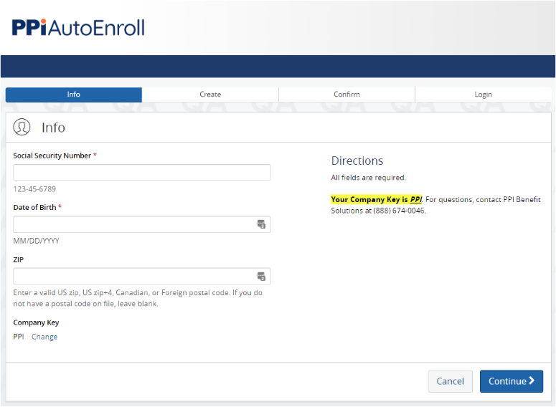
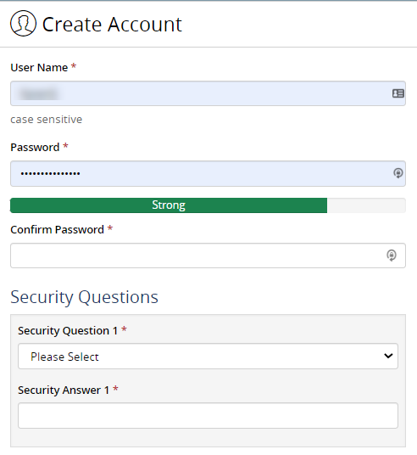
First Time Users
Select the Register button on the right of the login screen.
Enter your SSN, date of birth, and Zip code. Leave the company key as PPI.
Create a Username & Password then choose a security question and provide the answer.
Continue to the login page to access your secure enrollment site.

Slide 5
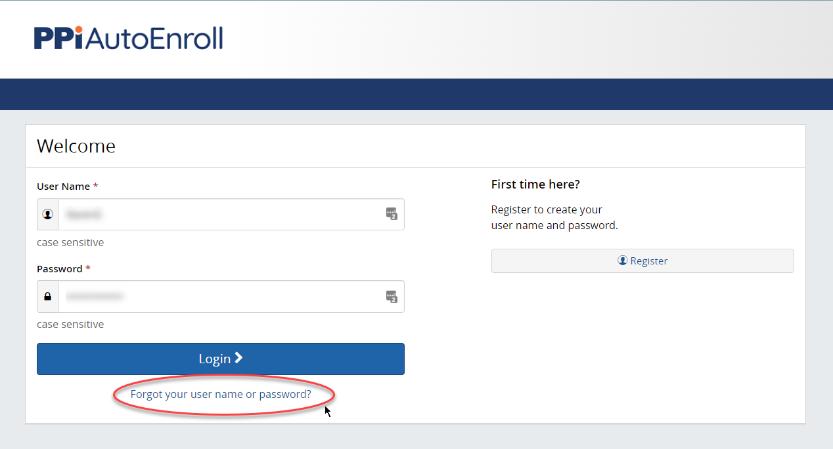
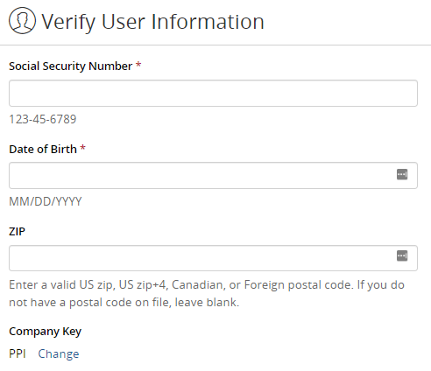
Returning Users
If you remember your username and password from last year’s open enrollment, enter it on the login page.
If you do not remember your username and/or password, click on “Forgot your username or password?”
You will be prompted to enter your Social Security Number, date of birth, and Zip code.
Hit “Continue.”

Slide 6
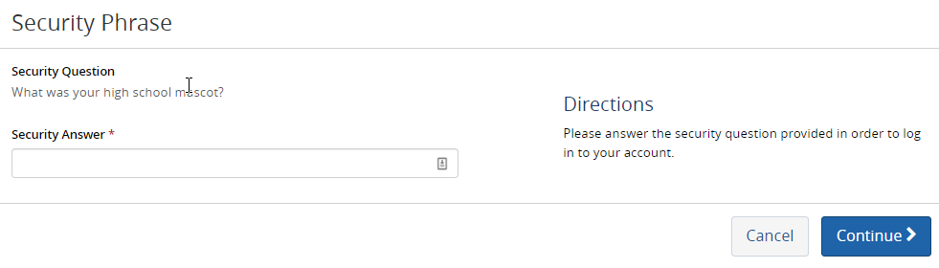
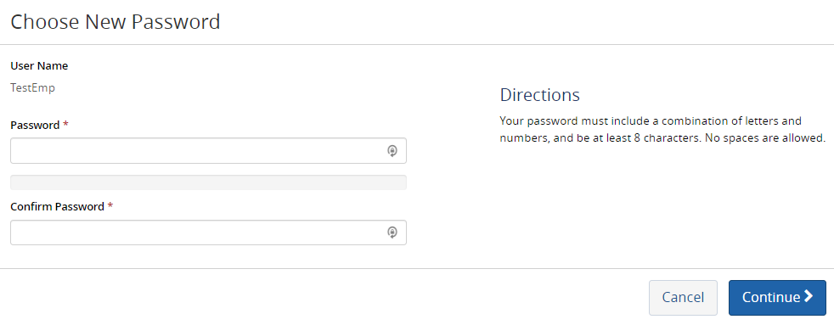
Returning Users
Answer the Security Question that you set up when you first registered for SelfEnroll and hit “Continue.”
(If you forgot your Security Question answer, contact clientservices@ppibenefits.com to reset your password.)
Choose a new password and click “Continue”.
Once you have reset your password and agreed to the terms, select “Continue” to go to the SelfEnroll home page.

Slide 7
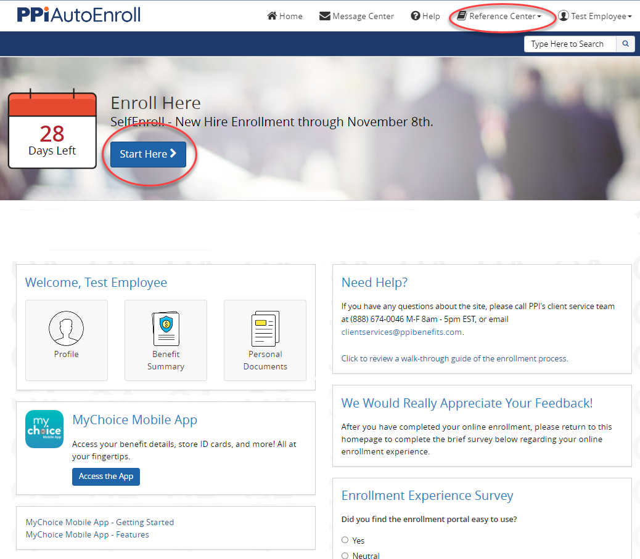
SelfEnroll for Open Enrollment
Employee Navigation
Review the Annual Open Enrollment message.
Visit the Reference Center for details on your benefit plan options.
Download the MyChoice Mobile App for access to benefits information where and when you need it.
Click the “Start Here” button to begin.

Slide 8
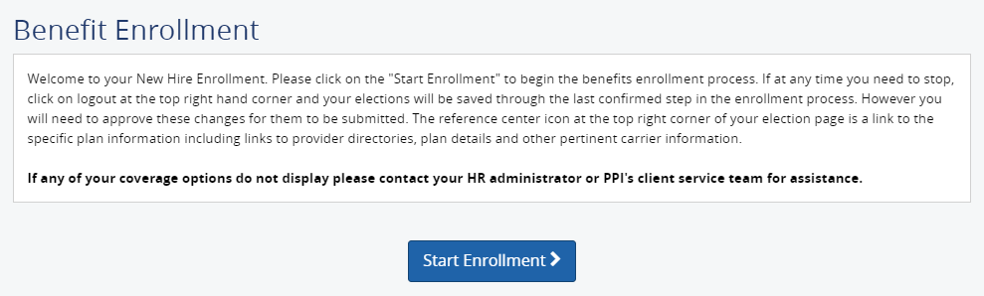
Benefits Enrollment
Click on the “Start Enrollment” button to enroll for coverage.
Always use the blue menu bar and “Start”, “Next” and “Previous” button options to navigate through the site. Do not use the toolbar options on your Web browser.

Slide 9
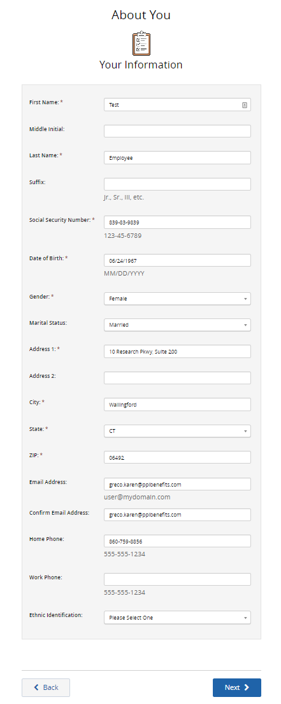
About You,
Your Information
Review Personal Information thoroughly, make sure all information is accurate, and check for typos.
Confirm that the address listed is where you receive mail – which may be different than where you live.
A quick link to the Reference Center is at the top of each screen.
The dialogue box on the left keeps track of your progress and plan costs based your payroll deduction schedule.
You must click the green Elect or Waive button for each benefit, before hitting “Next” in order to proceed

Slide 10
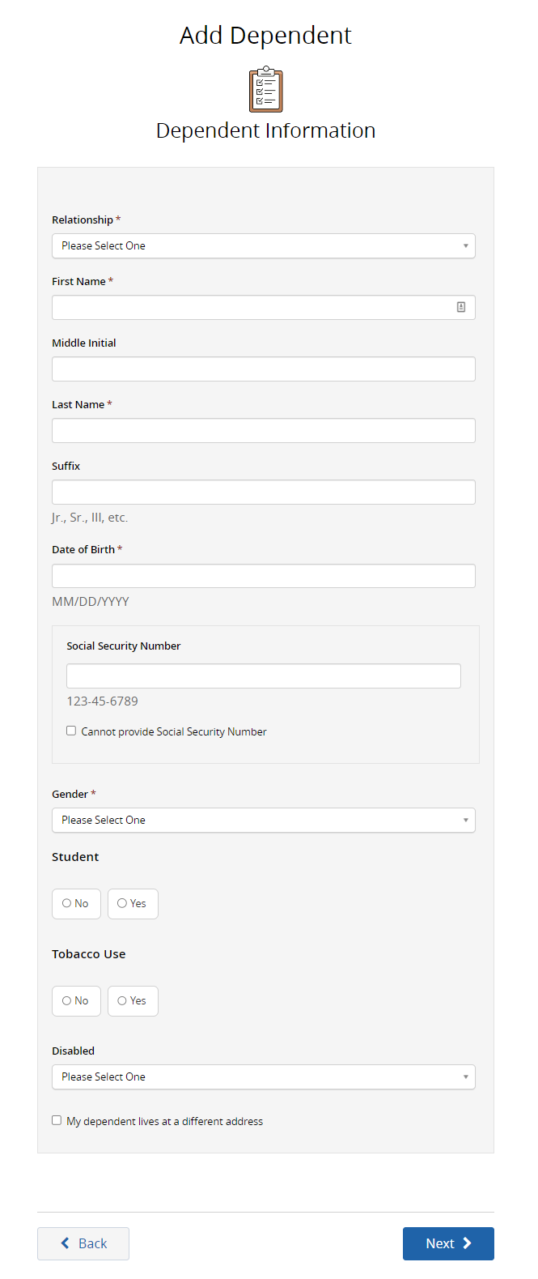
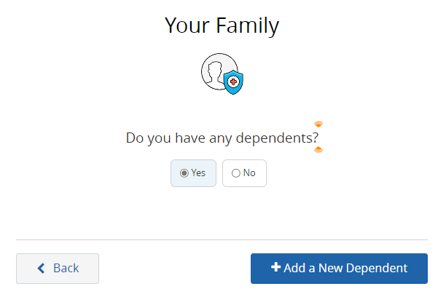
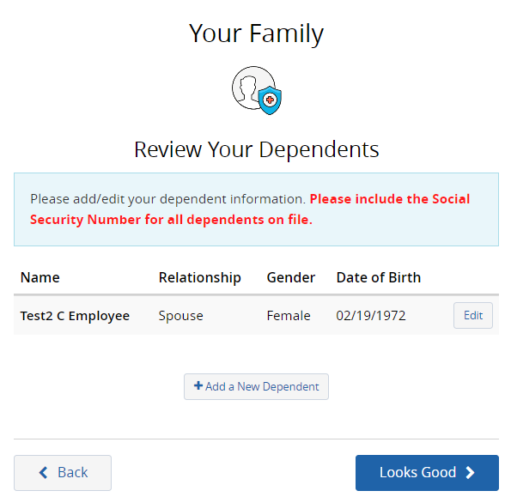
Dependent
Information
Add eligible dependents
as necessary:

Slide 11
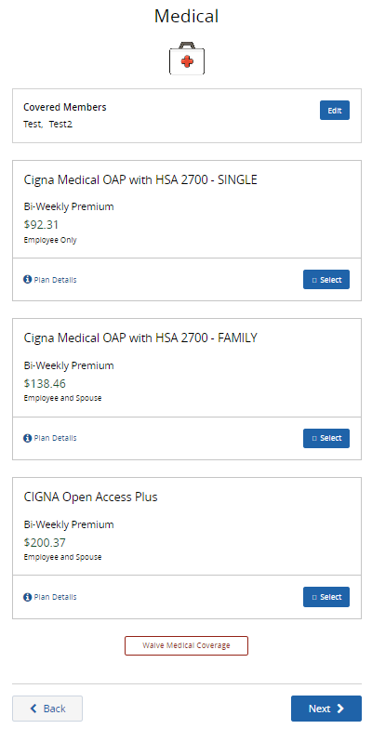
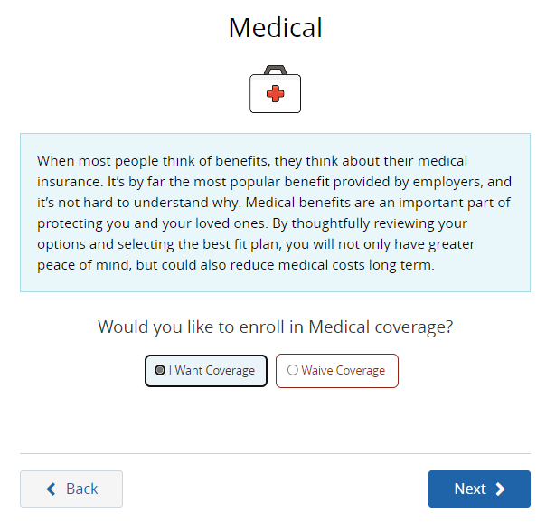
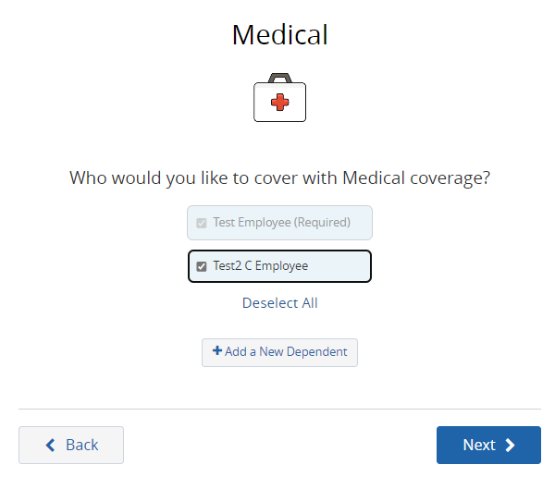
Plan Elections
Select if you want coverage or wish to waive.
Choose who you would like to cover under the plan.
Select a plan.

Slide 12
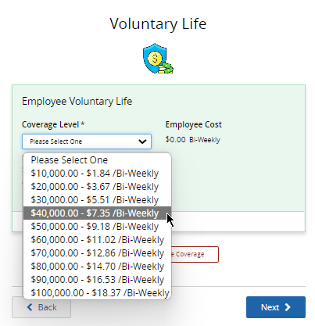
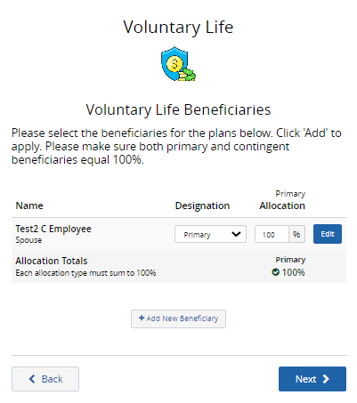
Voluntary Life
Voluntary life coverage options
for you will be displayed in a
drop-down menu when you
select the plan.
Designate a beneficiary for both Life and Voluntary Life. Even if it’s the same person.
Dependents you’ve added will automatically be listed, but you may add beneficiaries here.
If you have multiple primary and/or contingent beneficiaries on file, the total percentage designation must equal 100%.

Slide 13
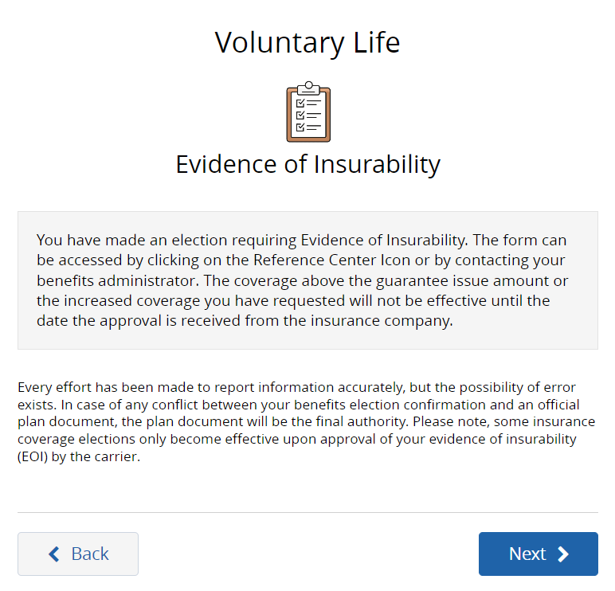
Voluntary Life
If your voluntary life election requires EOI, a message will display advising you to complete an EOI form available in the Reference Center.

Slide 14
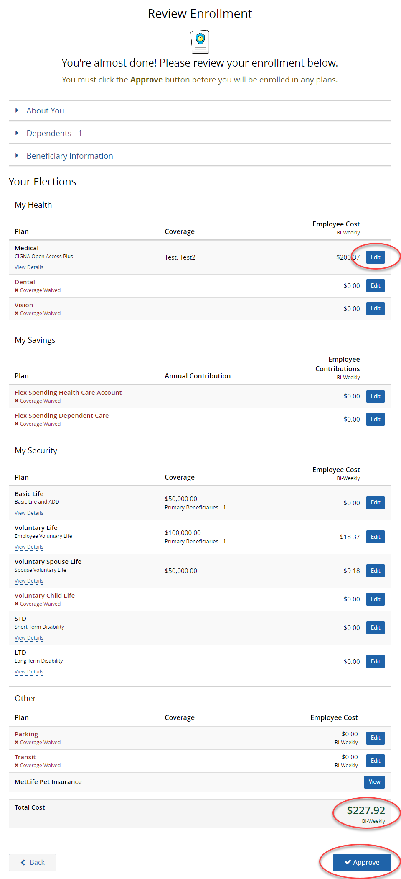
Review Enrollment
Review your open enrollment elections and total employee cost.
Click on the “Edit” buttons to make changes.
Click “Approve” then agree to the payroll deduction

Slide 15
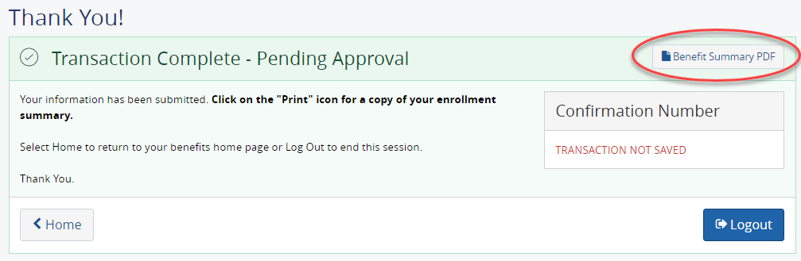
Confirmation
A confirmation number will be assigned to your transaction (the sample below was created from a test site that does not generate confirmation numbers).
You may print a copy of your Benefit Summary for your records.
Click “Home” to return to the home page or “Logout” to end your session.

Slide 16
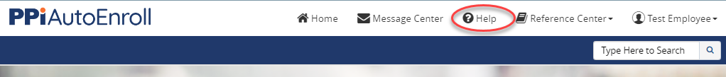
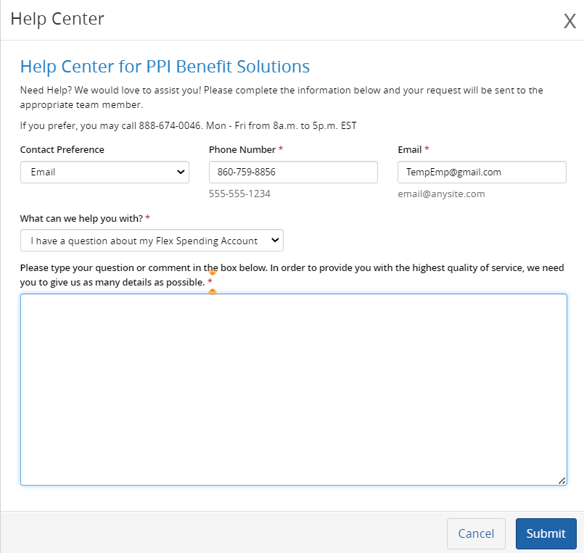
What if I need help?
PPI representatives available at
(888) 674-0046 weekdays, 8:00-5:00 ET
Use the “Help” feature in SelfEnroll or email clientservices@ppibenefits.com
Beyond open enrollment, PPI Service Representatives can help you:
    Understand your medical, dental and vision benefits
    Help with complex claims

